Slide 1

Welcome to Cowabunga Banking
A P0 Presentation
Presented by Kuavo Muhammad

Slide 2


Overview
Self-Intro
Readme
Imagery of Functionalities & Verbal Explanations
Helpful Best Practices
Future Improvements & Enhancements
Brief Demo showing Front-End Menus

Slide 3
Self-Introduction
Kutia-M’Yoni (Kuavo) Muhammad
Cohort 23052022
.NET - Full Stack Extended v3.0
Angelo State University Graduate, Class of 2021
Health & Human Services Sociology, Spanish Minor
Bilingual Social Justice & Empowerment Advocate
Army Veteran

Slide 4
Readme
3 Tier Architecture of a Banking Application
Allowing Admin and User Login
Using C# Development with .NET Framework 4.7.2
Applications used for programming: Visual Studio 2022 for User Interface and Reference Library, SQL Server Management Studios for Database Connection

Slide 5
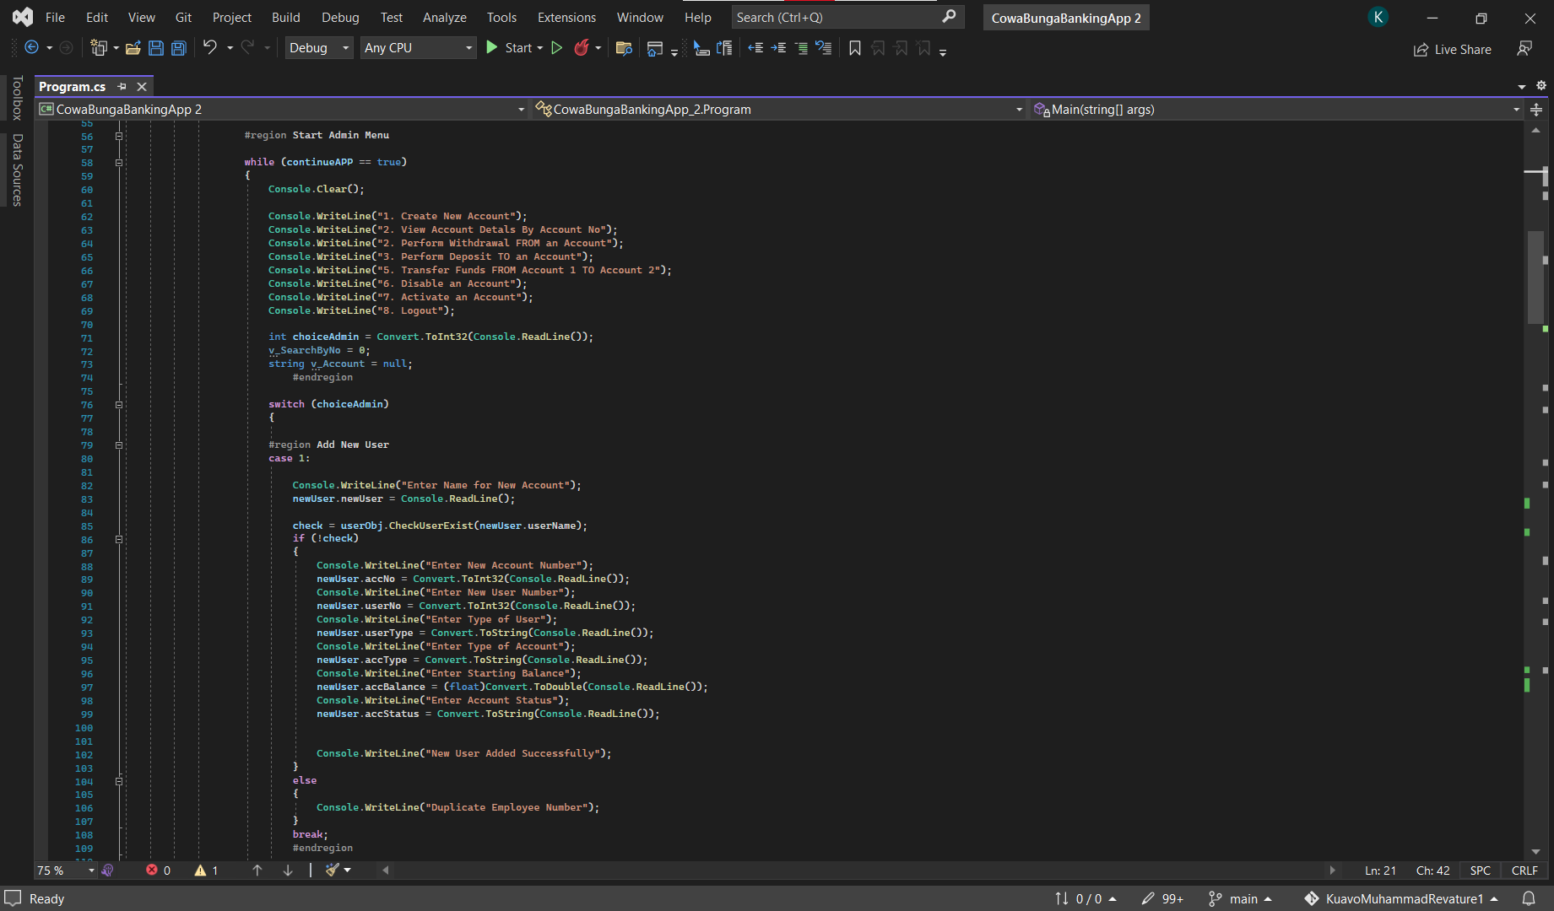
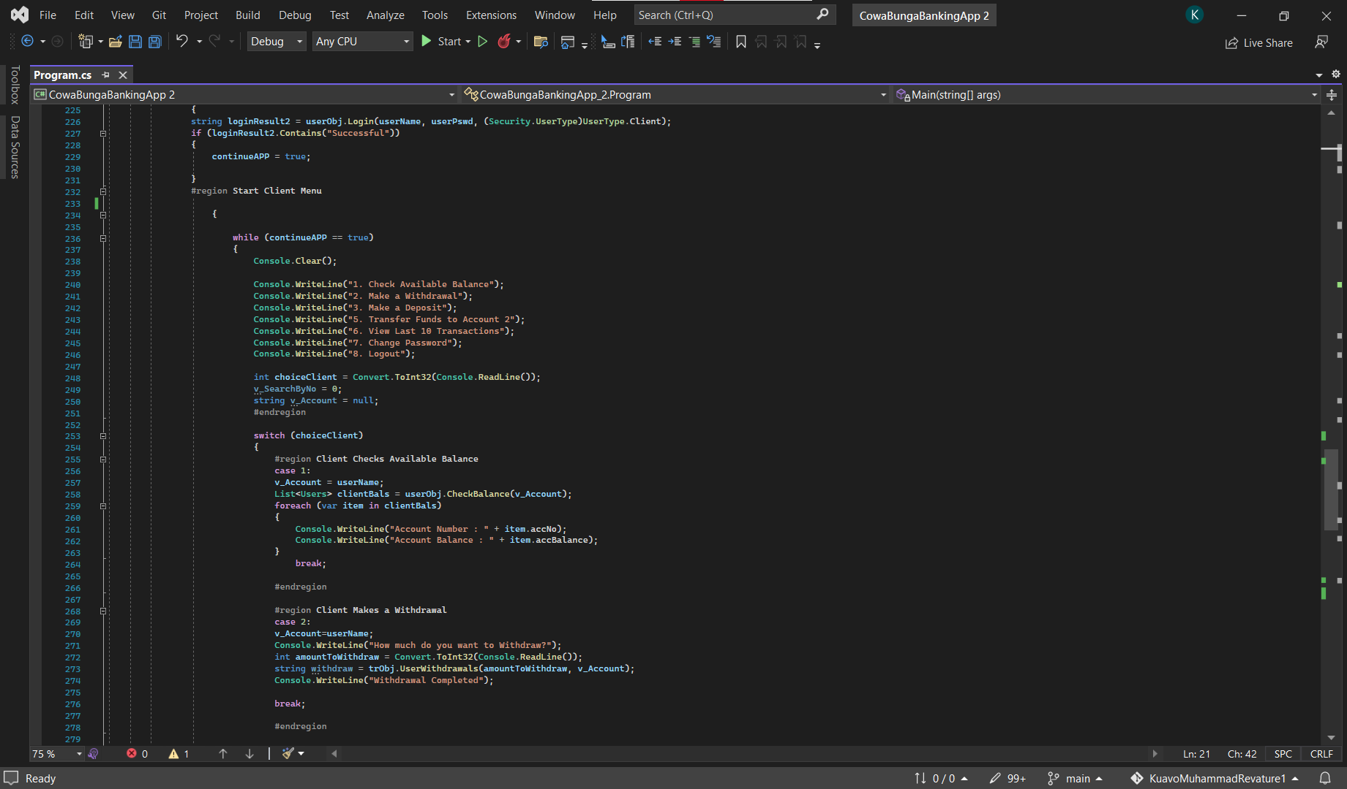
Imagery of Functionalities
Console Application

Slide 6
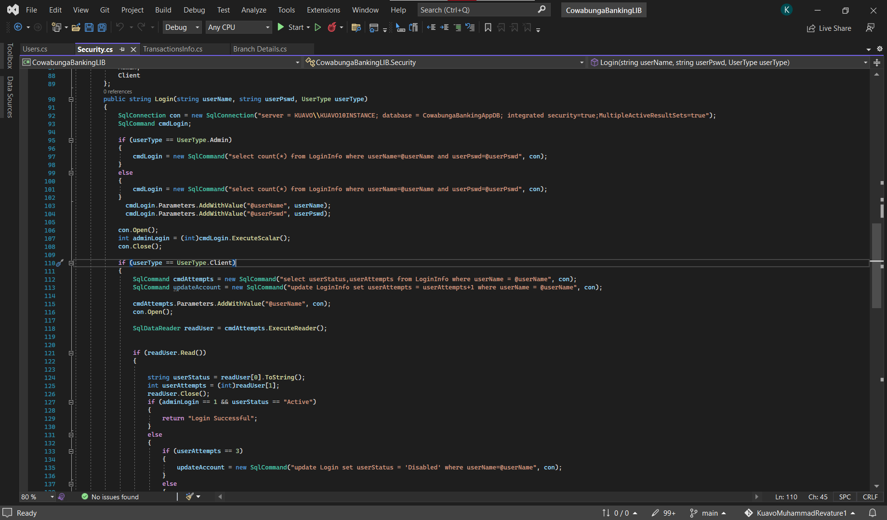
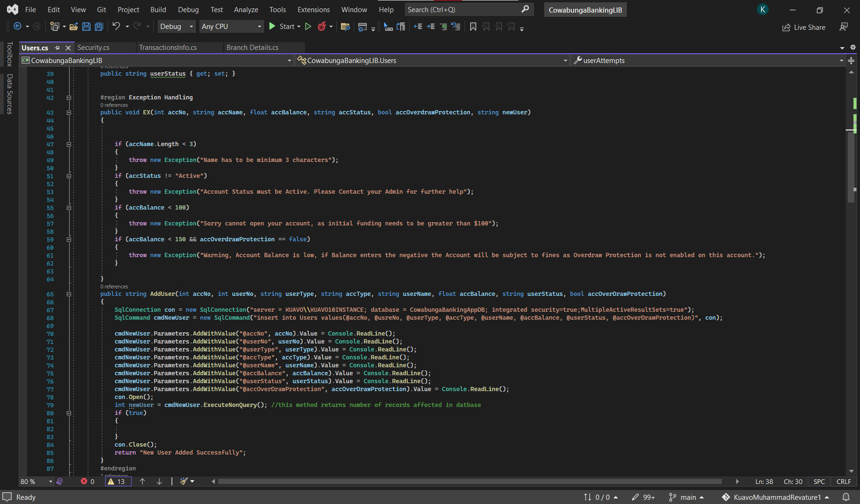
Imagery of Functionalities
Library Methods

Slide 7
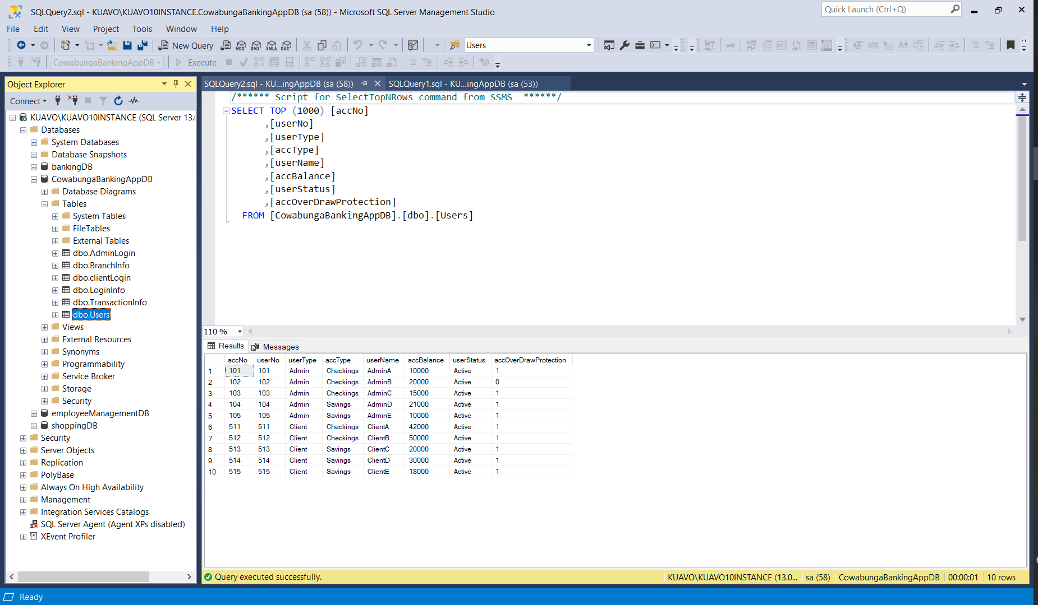
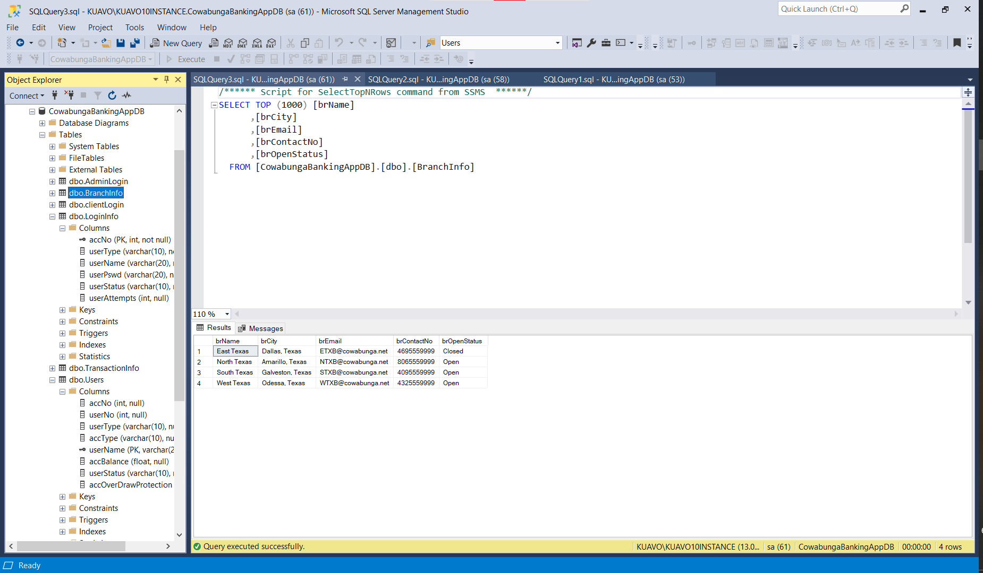
Imagery of Functionalities
Database and Some Tables Layout

Slide 8
Helpful Best Practices
Build As you go
Using available references & links
Asking the right questions
w3Schools
Docs.Microsoft.com
CSharpCorner.com

Slide 9


Future Improvements & enhancements
Return Account Balance after Deposit/Withdrawals and send an email notification to user
Exception Handling covering all foreseeable potential Admin/Client issues
Visually appeasing UI that engages the Client

Slide 10
A small Demo of the Cowabunga Banking Menu

Slide 11

A few moments for Questions

